Slide 1

Analysis : Traffic accidents in New York
Presentation assignment
(AMAN KUMAR)

Slide 2
Outline :
This presentation is based on graphical based analysis of traffic accidents due to motor vehicle collisions in New York. The analysis is well supported by insights derived from the trends & graphs and recommendations to overcome or avoid these accidents in future.
This presentation slides consist of :
Graphical representation of analysis
Insights & Recommendations
Synopsis / Summary
Links to dataset and Power BI pbix report file

Slide 3
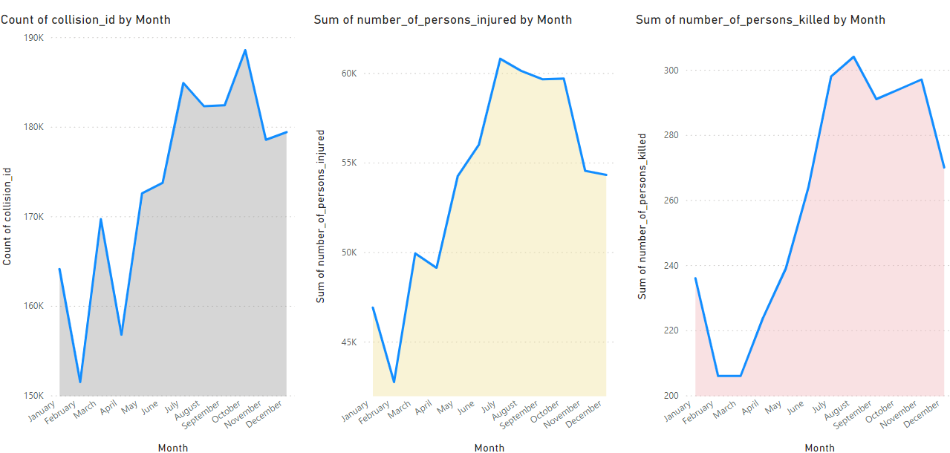
Cumulative count of accidents, injuries & deaths by month

Slide 4
… Insights & Recommendations
Cumulative number of accidents, injuries & deaths are relatively more in the months of May till December
These count peaks up in the months of July to October
These are mostly summer and autumn seasons in New York, so it is expected to have relatively more traffic
It is recommended to control the traffic by increasing checkpoints during these seasons to avoid accidents

Slide 5
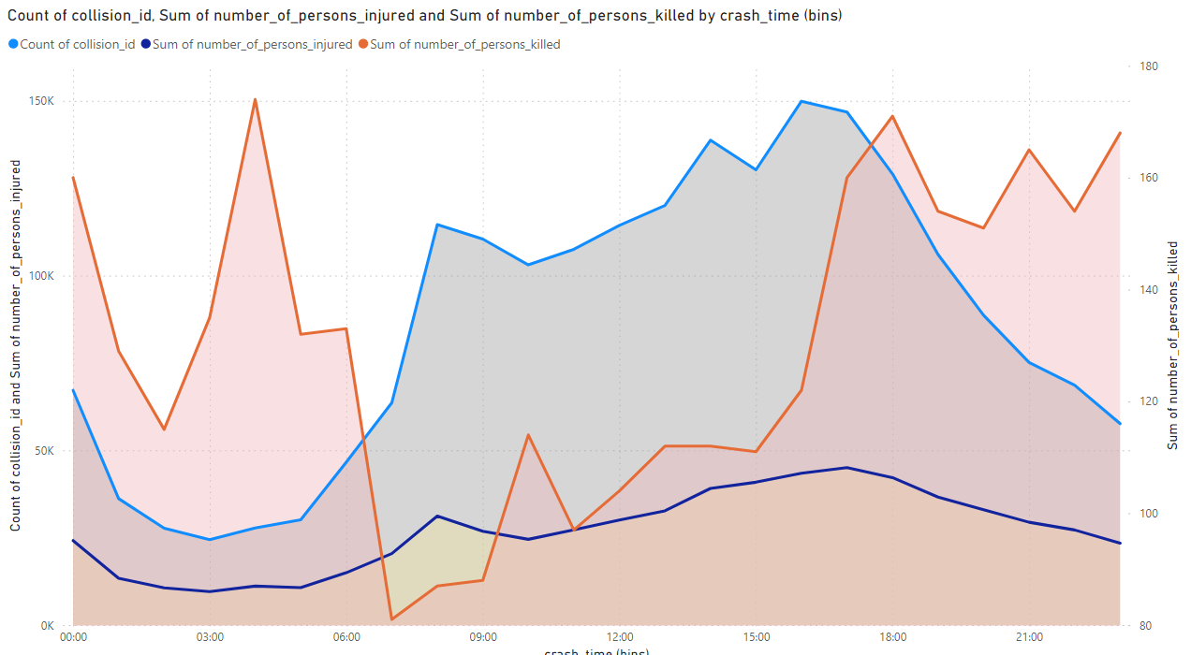
Trends of accidents, injuries & deaths over 24 hours time frame

Slide 6
… Insights & Recommendations
In this area chart, X-axis represents time of accidents happened and Y-axis shows number of accidents & injuries. Secondary Y-axis shows the number of deaths by hours over a day
No. of accidents & injuries are relatively higher between 06:00 hours morning and 21:00 hours evening
However, No. of deaths follow opposite trends it more after 18:00 hours evening and before 06:00 hour morning
It is recommended to mange the traffic better to lower the accidents during day time, and avail more ambulances and medical facilities during night to lower death rates

Slide 7
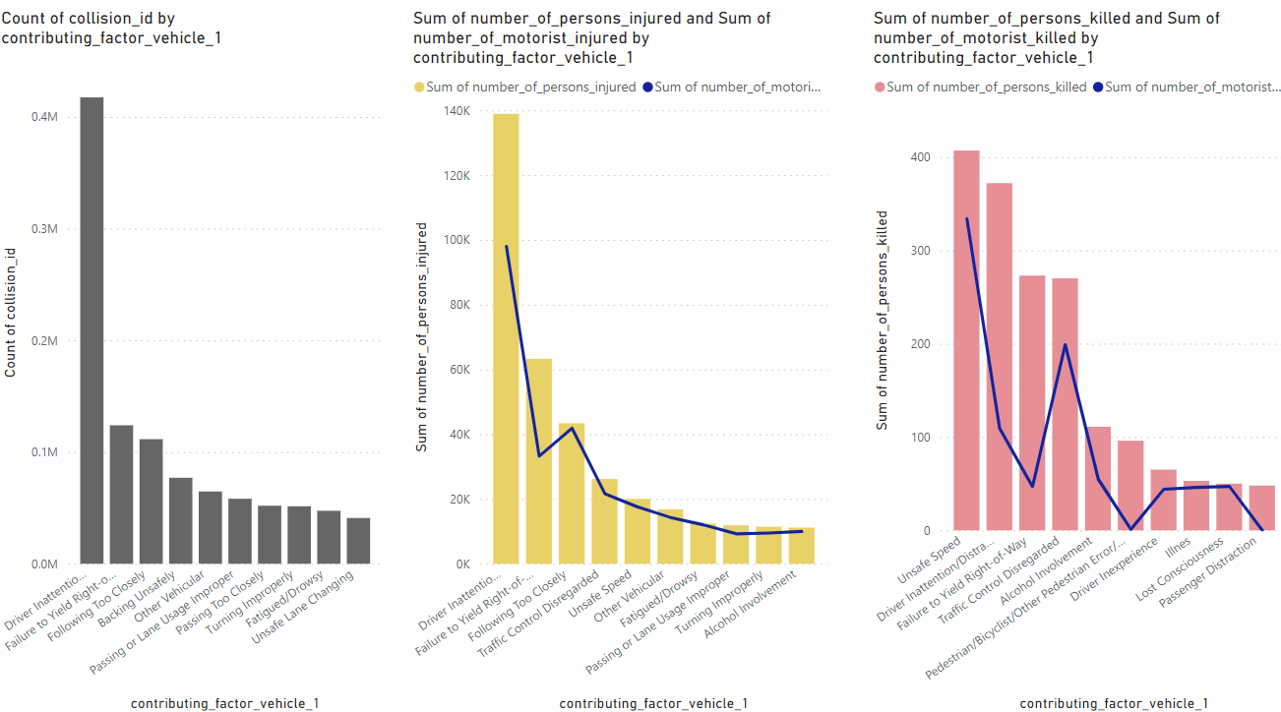
Top 10 factors affecting accidental, injuries & deaths count by Vehicle-1 involvement

Slide 8
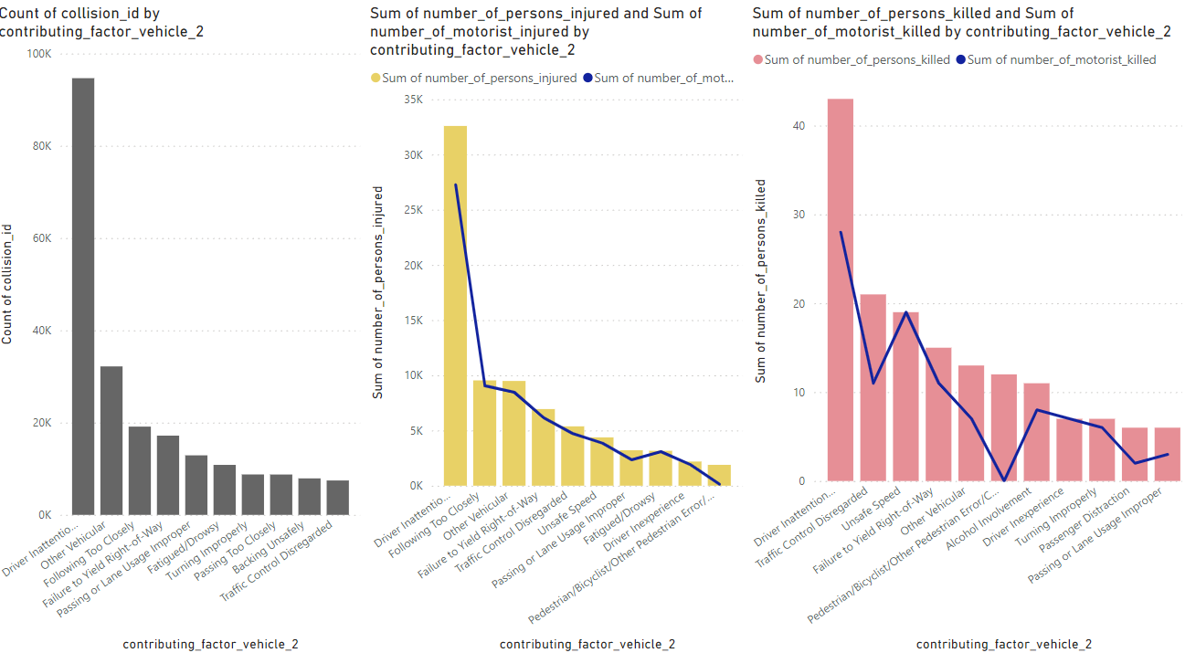
Top 10 factors affecting accidental, injuries & deaths count by Vehicle-2 involvement

Slide 9
… Insights & Recommendations
These charts show the top 10 factors which is contributing to accidents, injuries & deaths and ‘Driver Inattention/Distraction’ is the most common reason of all
‘Unsafe speed’ by vehicle-1 is the main reason of most deaths due to these accidents
The line in the graph shows the No. of motorist injured or killed in comparison to total person injured or killed
These factor analysis are done for vehicle-1 & vehicle-2 involved In accidents, we can do similar analysis for other vehicles as well
It is recommended to analysis top factors and take necessary actions to controls these factors contributing to majority of accidents, injuries & deaths

Slide 10
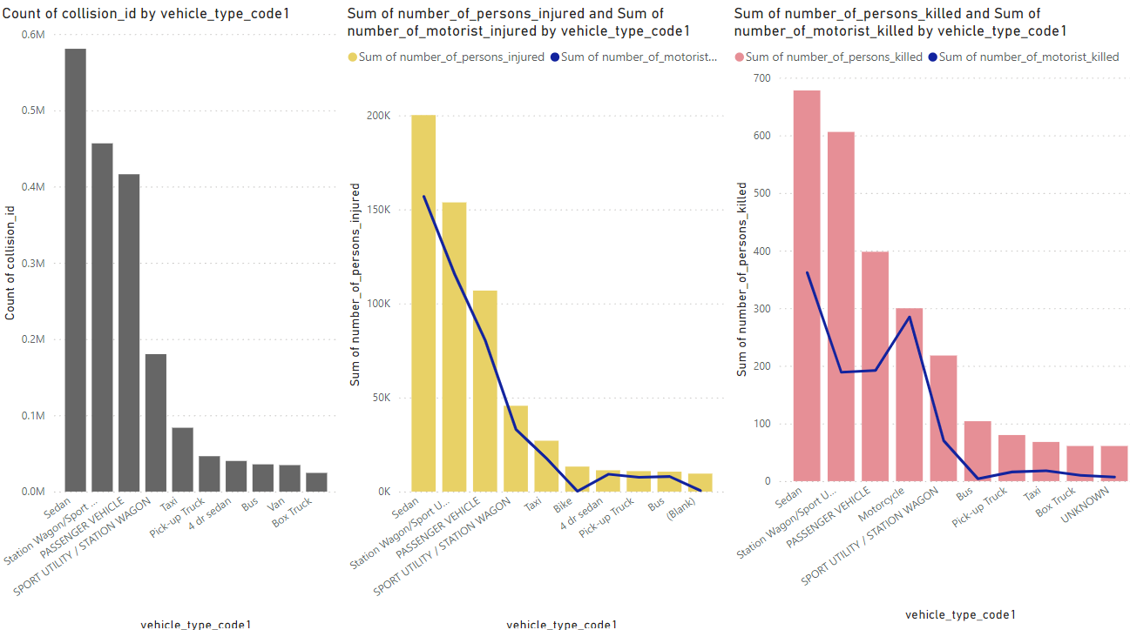
Top 10 Vehicle-1 Types contributing to accidental, injuries & deaths count

Slide 11
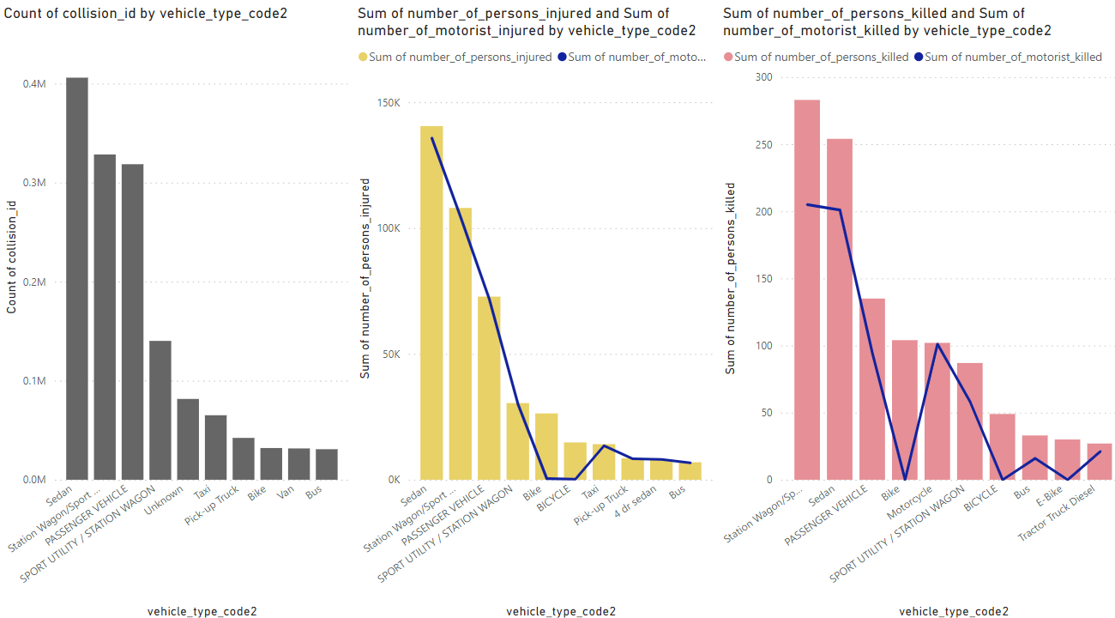
Top 10 Vehicle-2 Types contributing to accidental, injuries & deaths count

Slide 12
… Insights & Recommendations
These charts show the top 10 vehicle types which is contributing to accidents, injuries & deaths and ‘Sedan’, ‘Station Wagon/Sport Utility Vehicle’ and ‘PASSENGER VEHICLE’ are the most common vehicle types of all
The line in the graph shows the No. of motorist injured or killed in comparison to total person injured or killed. For motorcycle type, drivers are more prone to death whereas, for bus type, it affects more to pedestrians or cyclists
These vehicle type analysis are done for vehicle-1 & vehicle-2 involved In accidents, we can do similar analysis for other vehicles as well
It is recommended to bring out required regulations on these vehicle types to avid accidents, specially buses which cause death to other travellers

Slide 13
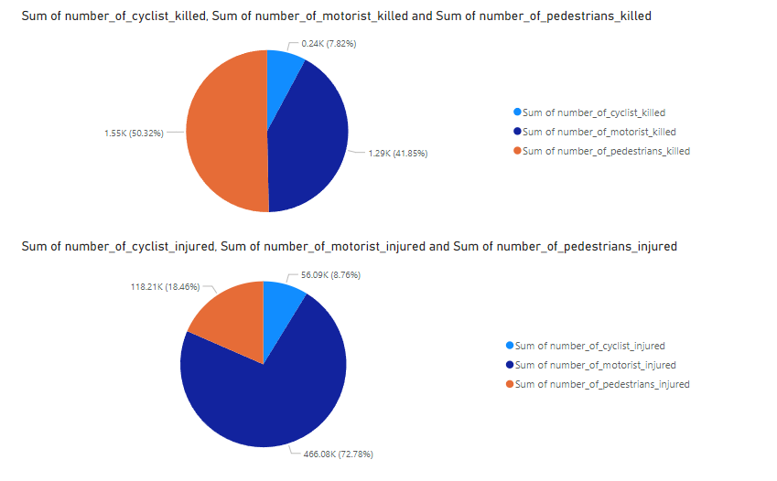
Ratio of cyclist, motorist and pedestrians killed & injured in the accidents

Slide 14
… Insights & Recommendations
These graphs show the % share of motorist/drivers, cyclists & pedestrians got injured or killed in the accidents
Although the % of motorists getting injured in the accidents are higher, but death % is higher for pedestrians
It is recommended to see if there are proper and well maintained footpaths are in place, also if zebra crossing is followed properly to let pedestrians pass the road safely

Slide 15
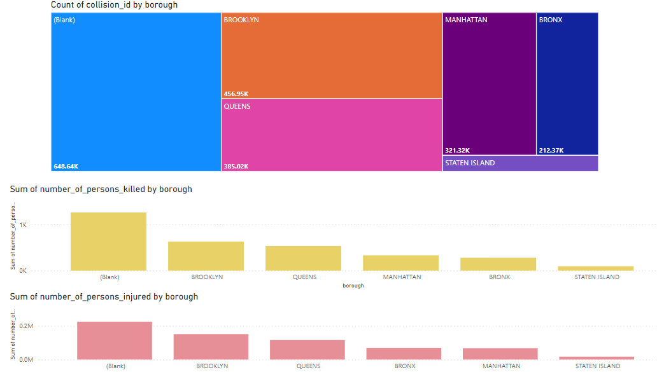
Count & distribution of accidents, injuries and deaths counts across different borough

Slide 16
… Insights & Recommendations
These graphs represent the order of different boroughs of NYC by total counts of accidents, injuries & deaths
Although there are many blank records for this, but BROOKYLN & QUEENS have relatively higher number of accidents resulting to higher injuries & deaths, followed by MANHATTAN, BRONX & least in STATEN ISLAND
It is recommended to review rules & regulations for these top accident prone boroughs to bring down the count of casualties and deaths

Slide 17
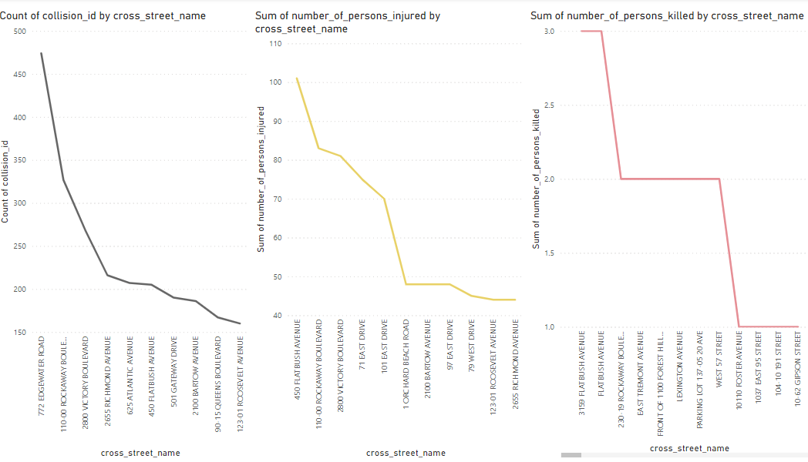
Top 10 cross streets based on count of accidents, injuries & deaths

Slide 18
… Insights & Recommendations
This is a plot to top 10 cross streets which are more prone to accidents resulting in injuries & deaths
We can review top 5 streets where accidents & injuries are very high in number
Deaths counts are almost same across all streets which is 1 barring few where death counts are 2 or 3
It is recommended to better implement the traffic rules on these streets, also traffic congestions can be monitored for these streets and if possible infrastructure development can be done around these streets to reduce traffic and accidents

Slide 19
Synopsis :
Analysis comments
The count of accidents, injuries & deaths analysis is performed on various parameters like seasonality, 1-day hours, vehicles type involved in accidents & also the factors causing these accidents.
Also, boroughs and streets across New York are analysed which are resulting in more accidents.
We also did comparative analysis on deaths due to these accidents to reduce the loss of life
Recommendations
Recommendations around each graphical analysis have been provided which includes, monitoring the traffic during peak hours and peak seasons
Also, reviewing regulations and implementing rules to control the factors and vehicle types which are resulting to more accidents, casualties & deaths
We have to improve infrastructure as well to control the high accidents-prone streets, and also for pedestrians safety

Slide 20
Links / References :
Public Dataset Link
https://data.cityofnewyork.us/Public-Safety/Motor-Vehicle-Collisions-Crashes/h9gi-nx95/data_preview
Power BI reports pbix file with OData feed connections to dataset Link
https://drive.google.com/file/d/1AWl-jSqYd1w0fBqWHhco-ZeNzZxXj7Sx/view?usp=sharing

Slide 21
Thank You !

